Slide 1
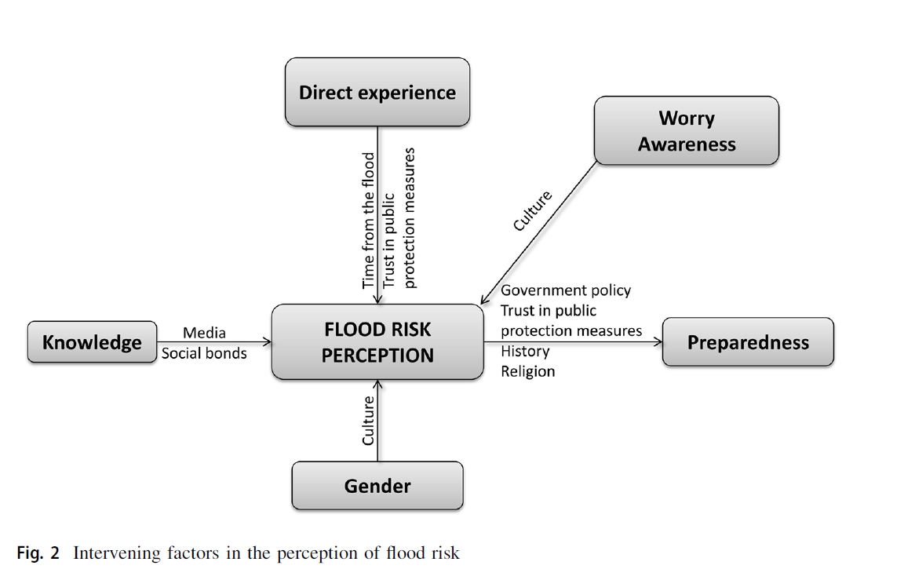
Immersive virtual environment designed for flood risk communication
Jaeyoung Ha, Nicholas Polys, David Sample, Terry Clements
Background & Research Gap
Our research team aims to pioneer an immersive flooding simulation using Immersive Virtual Reality technology to assess community risk perception and psychological impact.
Our research team is developing
1) immersive virtual digital twin models that visualize the flooding impacts related to climate change
2) an effective risk communication platform for local communities and planning professionals
3) an interactive engagement workshop toolkit for collaborative resilience planning.
Reference: What determines flood risk perception? A review of factors of flood risk perception and relations between its basic elements
ICAT Pecha Kucha Presentation
Page 1

Slide 2
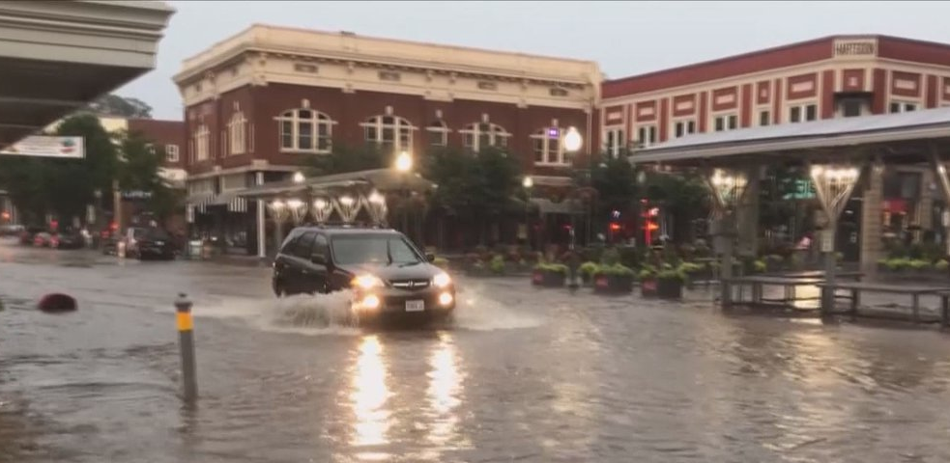
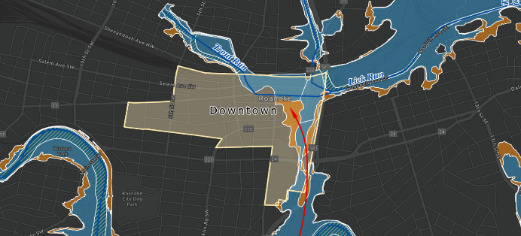
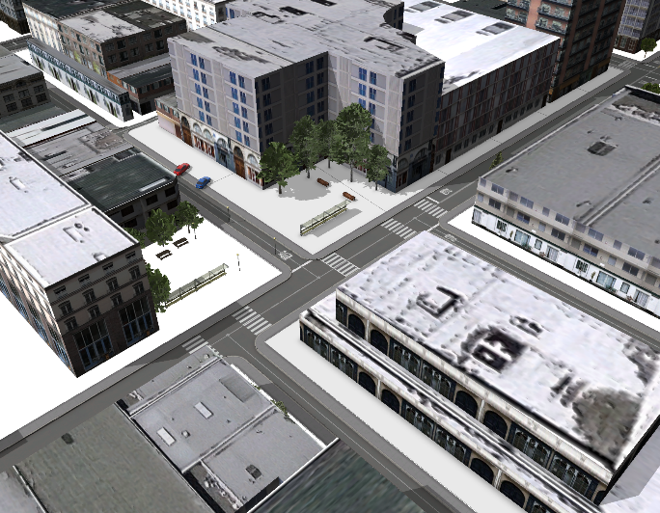
Immersive virtual environment designed for flood risk communication
Jaeyoung Ha, Nicholas Polys, David Sample, Terry Clements
Study area: Roanoke Downtown, VA
Left: Downtown flooding in 2017, Right: flooding map in Roanoke
ICAT Pecha Kucha Presentation
Page 2
Storm Water Management Model (SWMM)
CityEngine 3D Model

Slide 3
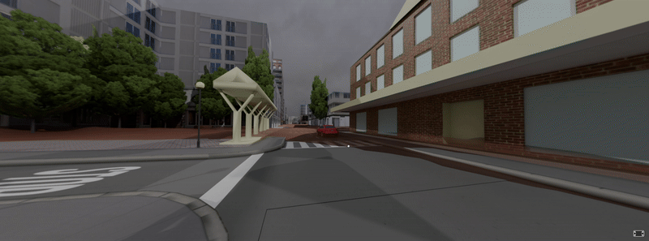
Immersive virtual environment designed for flood risk communication
Jaeyoung Ha, Nicholas Polys, David Sample, Terry Clements
Flooding Simulation Demonstration
ICAT Pecha Kucha Presentation
Page 3

