Slide 1
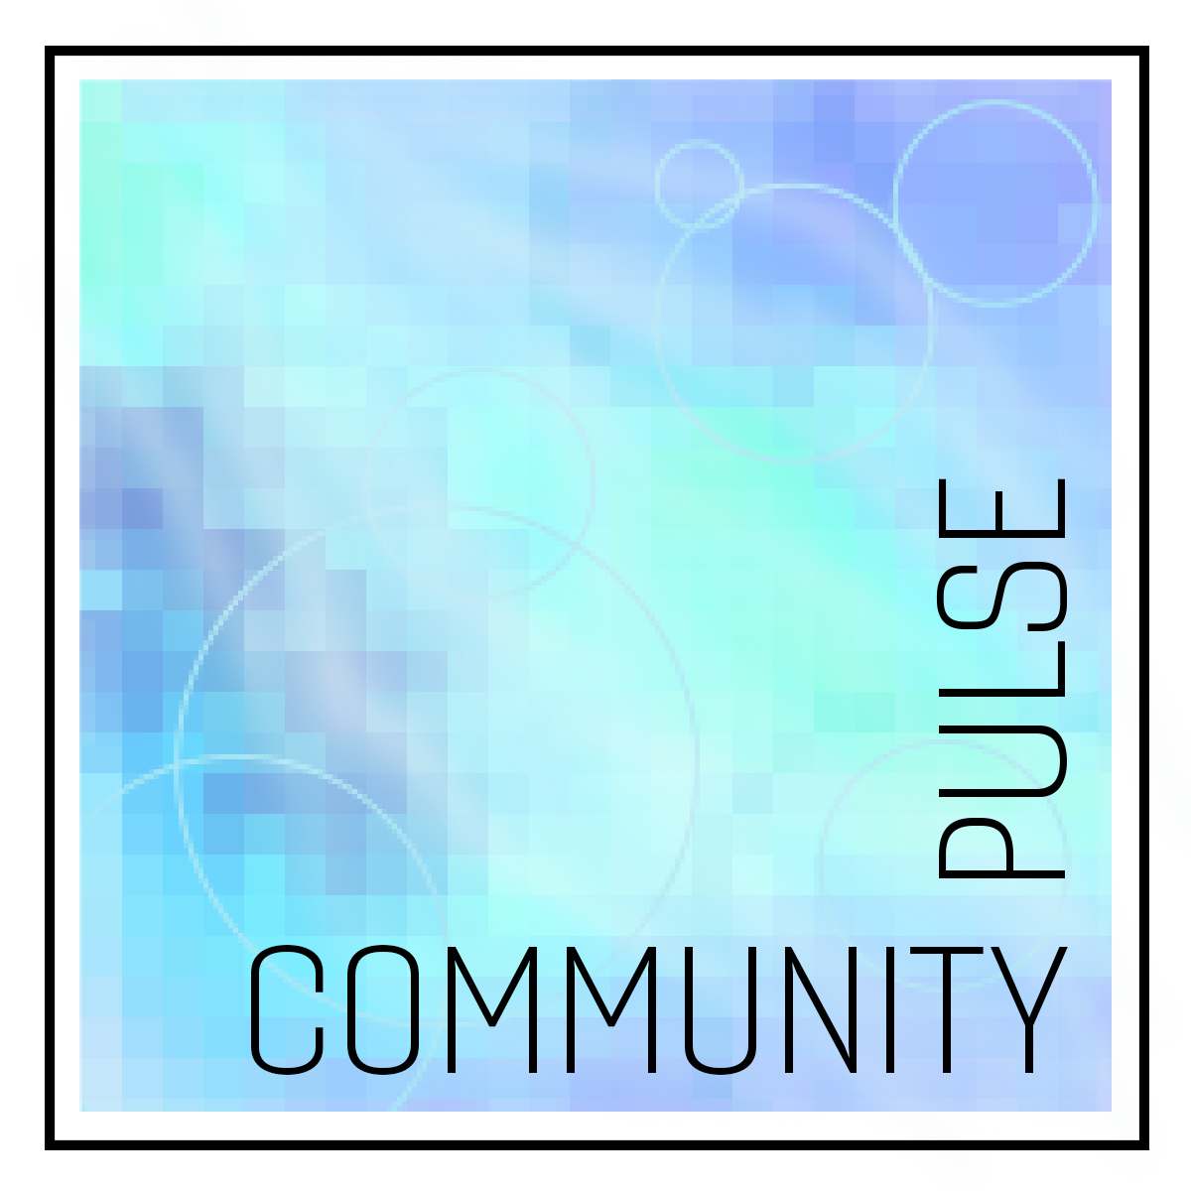
Community Pulse
Caillyn Jeffery (PI), Anthony Cusat, Kermie Sherer, Ayat Mohammed (Collaborator)
How can art & color help us better understand our communities? Community Pulse is an interdisciplinary fine arts project that will visually represent the emotional well-being of a specified community.
Our research and methodology works at the intersection of visual arts, color theory, psychology, and computer science. Users within a chosen community will complete a survey assessing their emotional well-being. In turn, each user will be assigned a specific color that reflects averages of their emotional “data”.
These individual colors will be reflected in our final art piece; over time and with additional user input, our artwork will update and change, and in turn summarize the emotional well-being of the community as a whole.

Slide 2
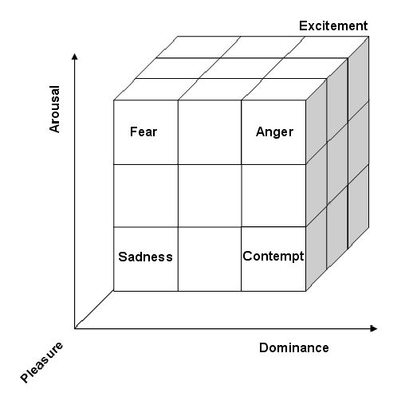
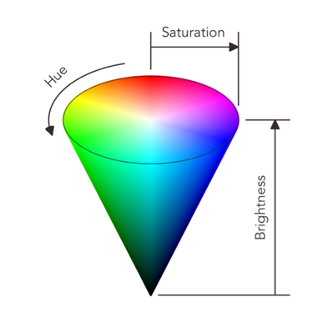
Progress & Research
Currently on Phase 2 (finalizing visual language & developing community survey)
Preliminary research questionnaire still pending
PAD & HSB/HSV system for computing emotion into color
Our research on color’s effect on emotion shows that:
People generally associated emotions with negative connotations with purple, red, and yellow.
People generally associated emotions with positive connotations with blue and green.
Colors that leaned towards black were generally associated with emotions with higher dominance.
Colors that were more saturated were generally associated with more intense emotions.
Using this research, we have developed a new model:
Pleasure = Hue
Arousal = Saturation
Dominance = Brightness
PAD model (first developed by Mehrabian & Russell, 1974) categorizes emotion on three scales- pleasure (desirability), dominance (pointedness or outwardness) and arousal (intensity).
HSB (or HSV) model categorizes color on three scales- hue, saturation, and brightness or value. Similar to RGB, this is a method for computers to identify and categorize color.
Lowest P, A, & D
Highest P, A, & D
Happy
Sad

Slide 3
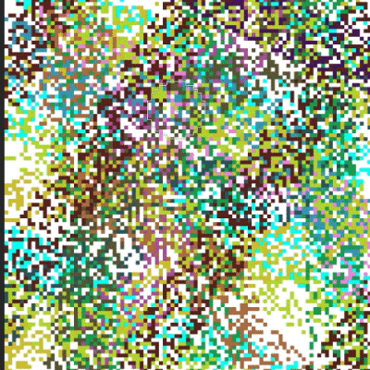
Challenges & What’s Next
Obstacles with research questionnaire
IRB approval & working with grant money
Obstacles with complexity of project
Focus on emotional well-being, as opposed to overall well-being
Phase 3: January 31st to March 31st
Finalizing survey
Finalizing how colors will translate onto the final art piece
Finalizing display within CID
Creating code to run the art piece
Phase 4: April 1st to May 2nd
Marketing & outreach
Develop accompanying materials for display
Goal: minimum 25 survey responses

