Slide 1
BIOTECH COUTURE
Mariam Hasan
Minakshi Seth
Leah Thomas
RJ Weaver
Notes:
The format for your presentation (PI required and other team members optional) is as follows.
3 slides – 1 min each
Slide 1: What you are working on
Slide 2: Where you are in the project
Slide 3: Challenges faced preventing the project from completing or moving forward.

Slide 2
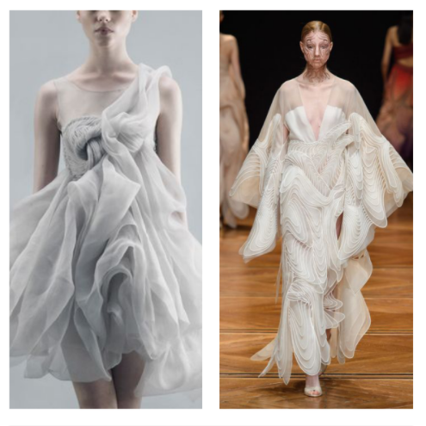
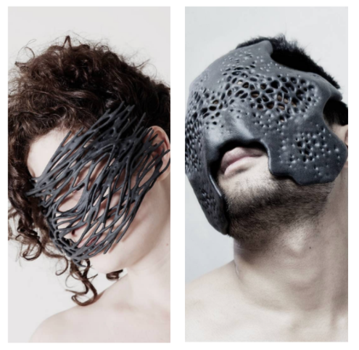
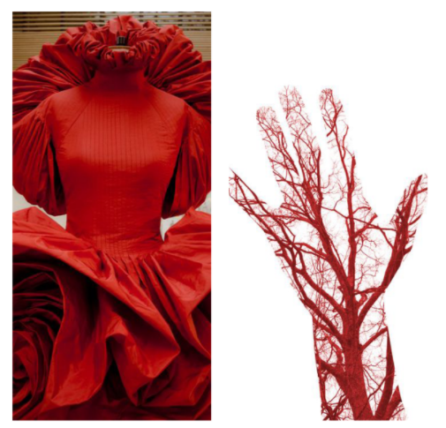
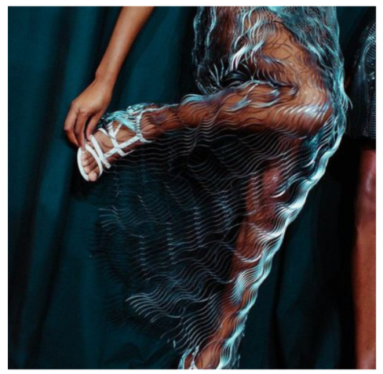
OUR PROJECT
To design and construct four couture dresses which integrate bio-inspired design, medical wearables, data visualizations, and computationally designed 3D printed sculptural jewelry.
The goal of this project is to spark conversation about the intersection between design and engineering and ideating beyond the typical constraints of wearable biosensor technology.
Notes:
Slide 1: What you are working on
RJ thinks he likes this layout slightly more

Slide 3
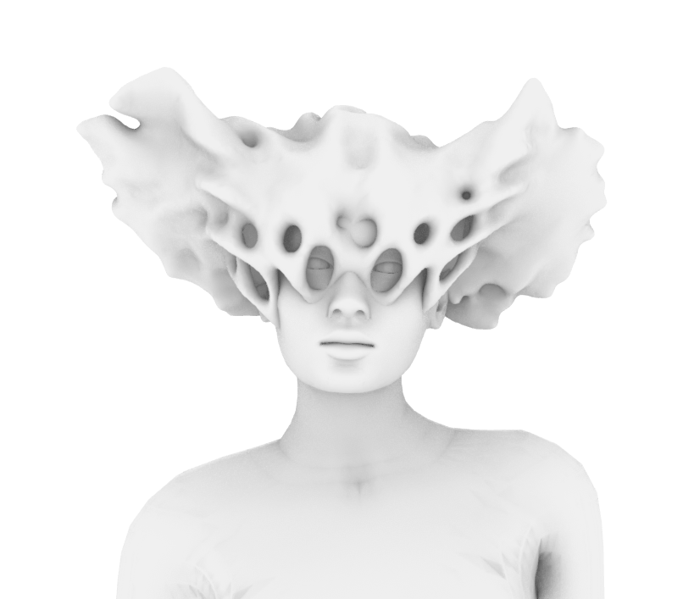
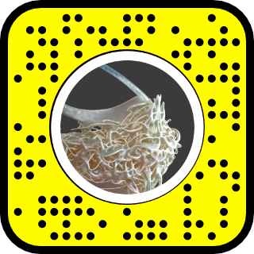
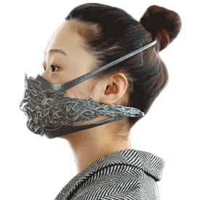
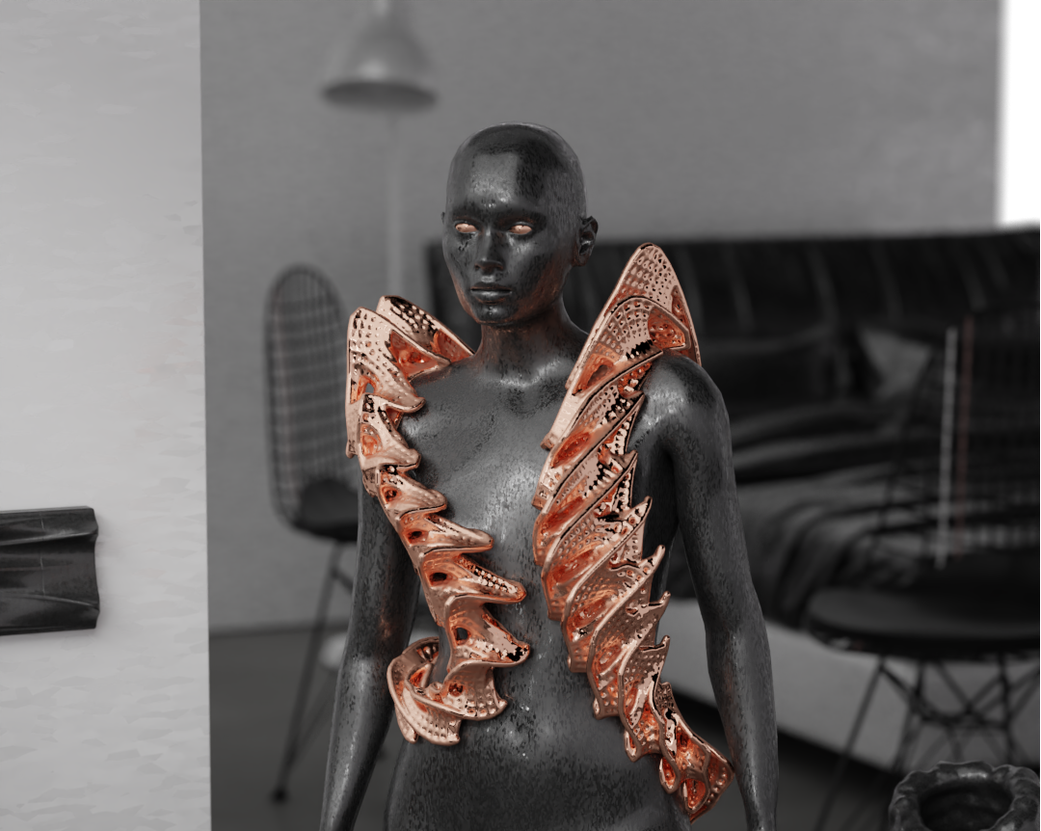
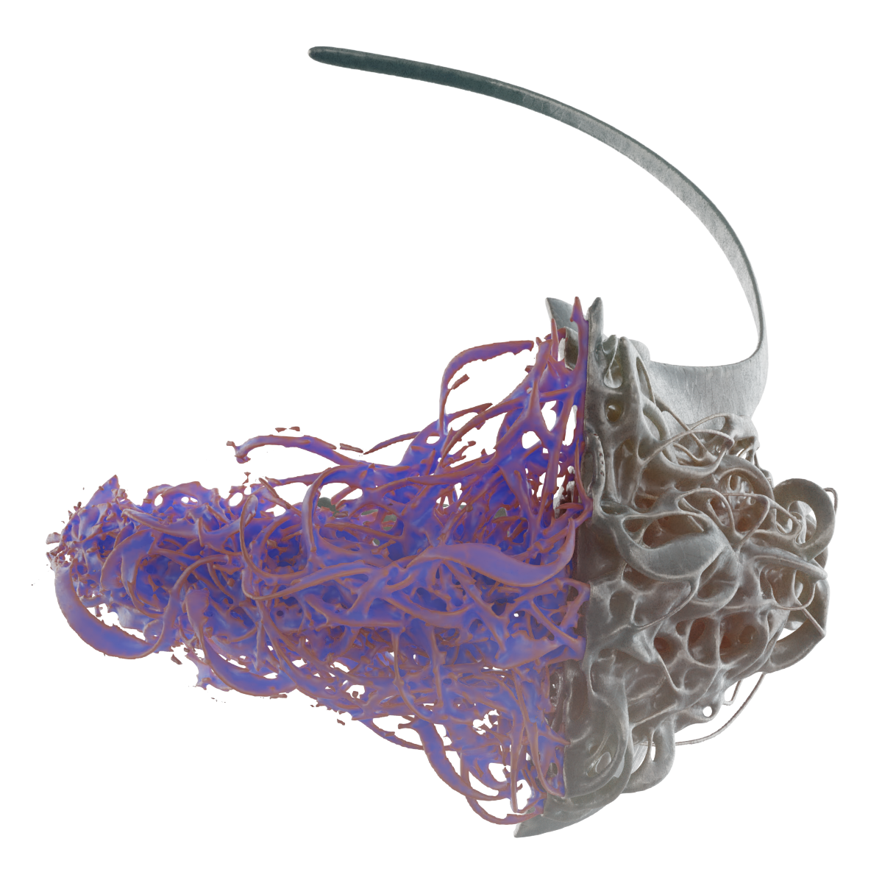
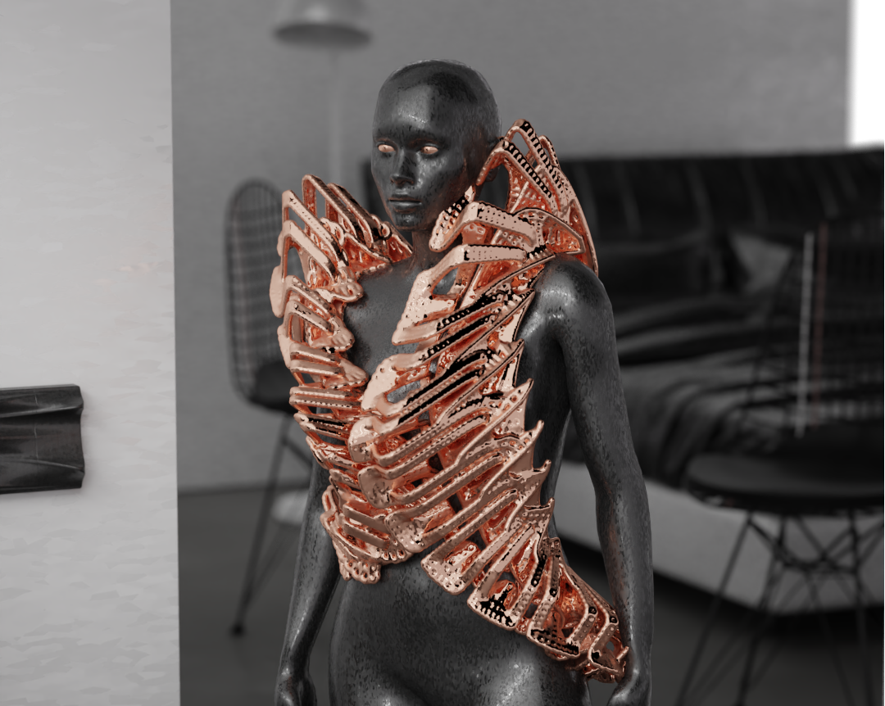
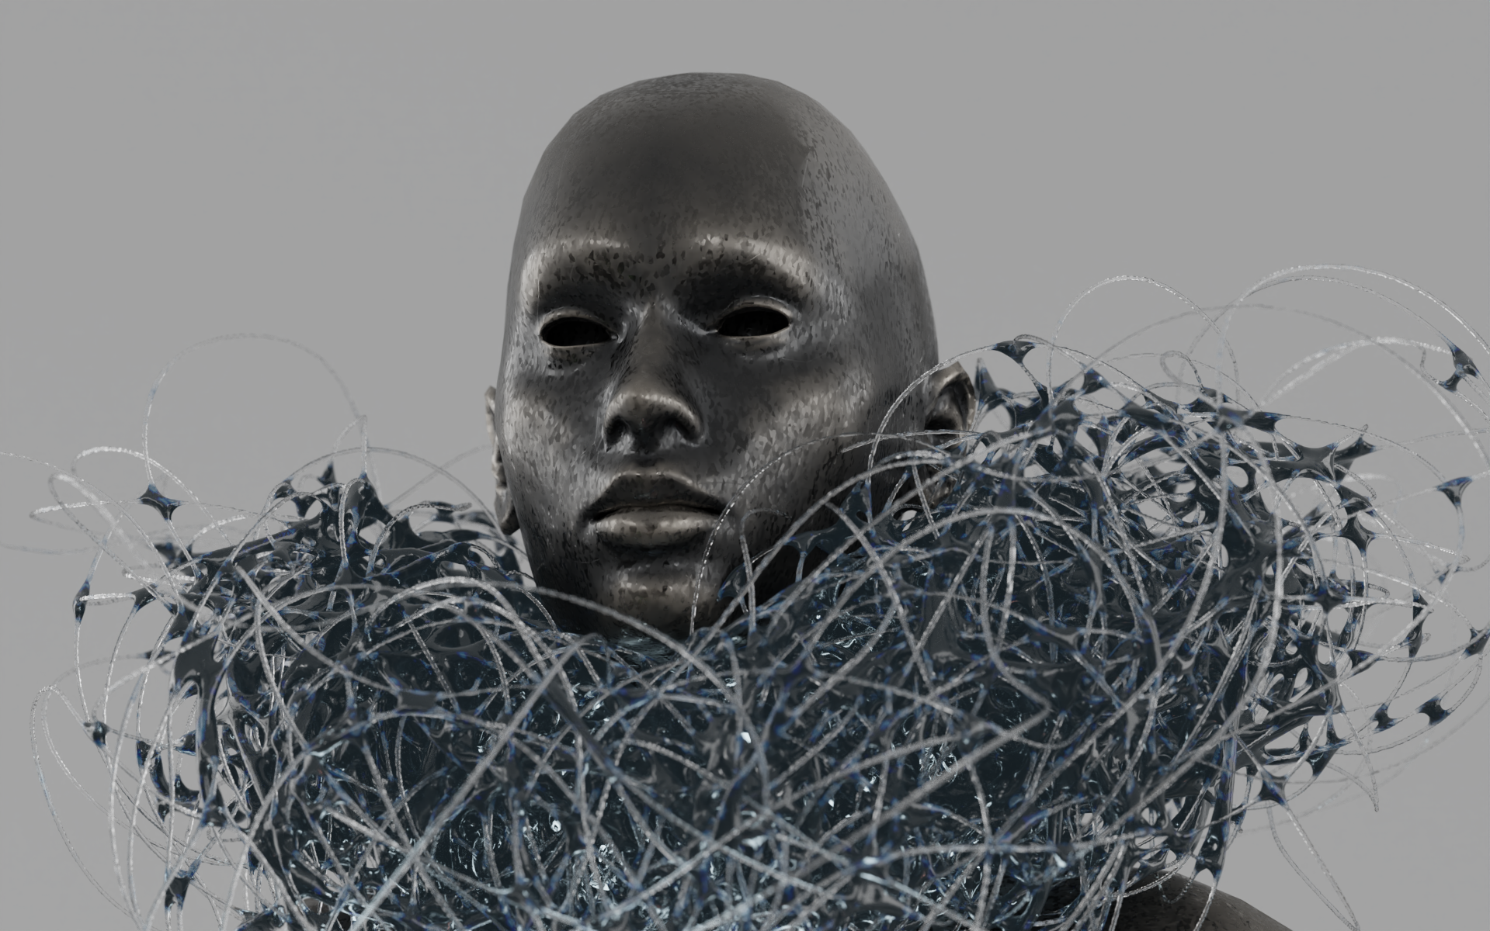
CURRENT PROGRESS
Notes:
Slide 2: Where you are in the project

Slide 4
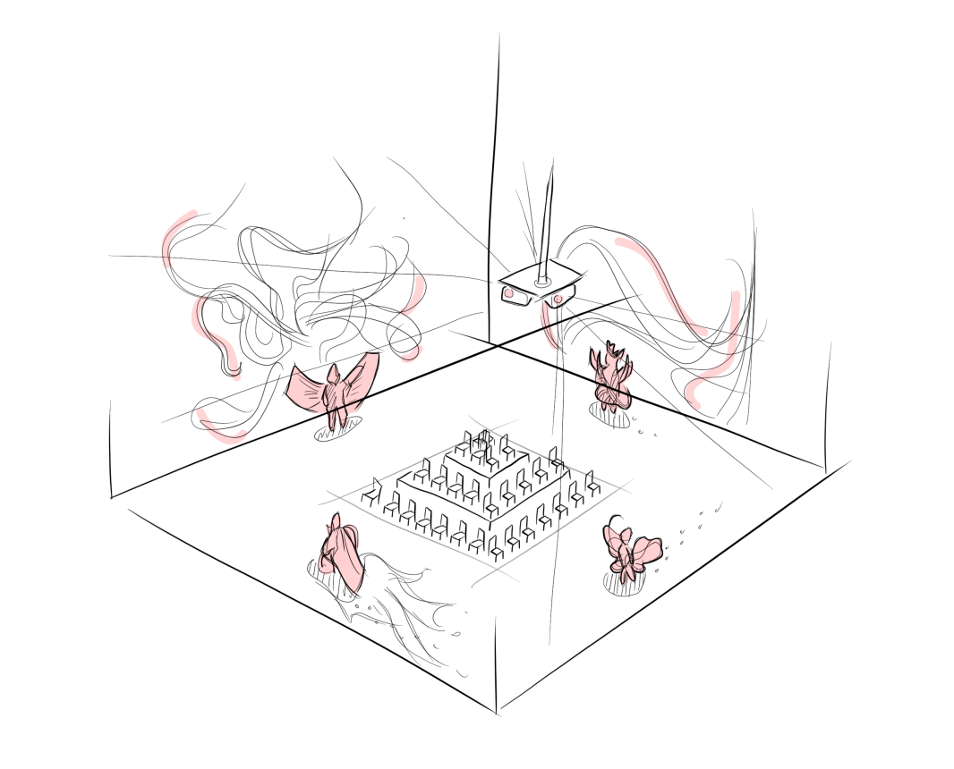
CHALLENGES
Finding a venue
Possible ideas
Creativity and Innovation District
The Cube
The Armory
Notes:
Slide 3: Challenges faced preventing the project from completing or moving forward.

