Slide 1
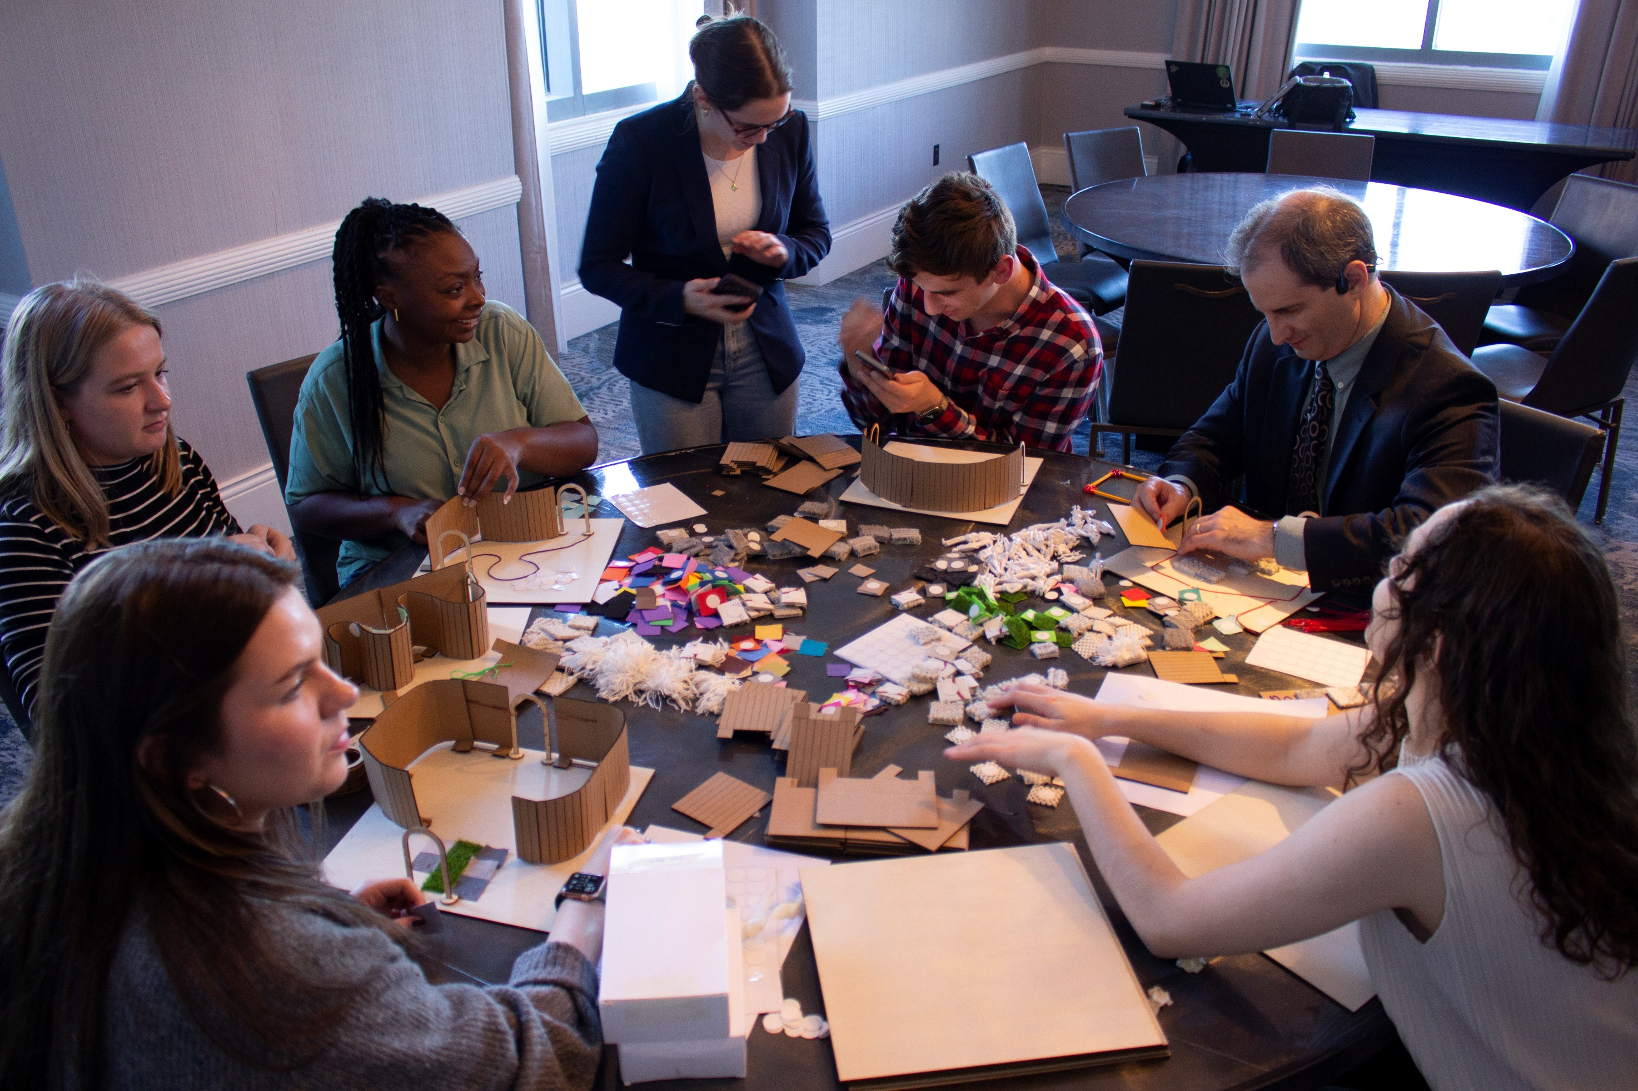
AI-ACCESSIBILITY (1/3)

Slide 2
AI-ACCESSIBILITY (2/3)

Slide 3
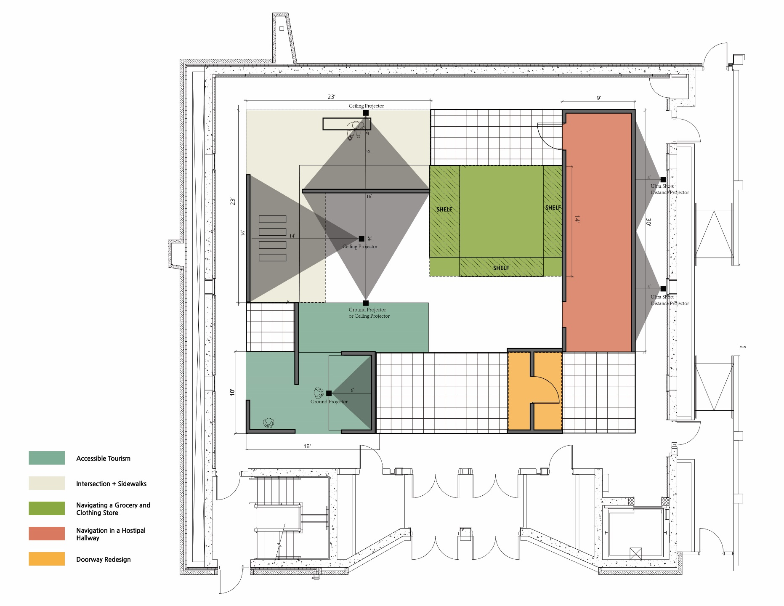
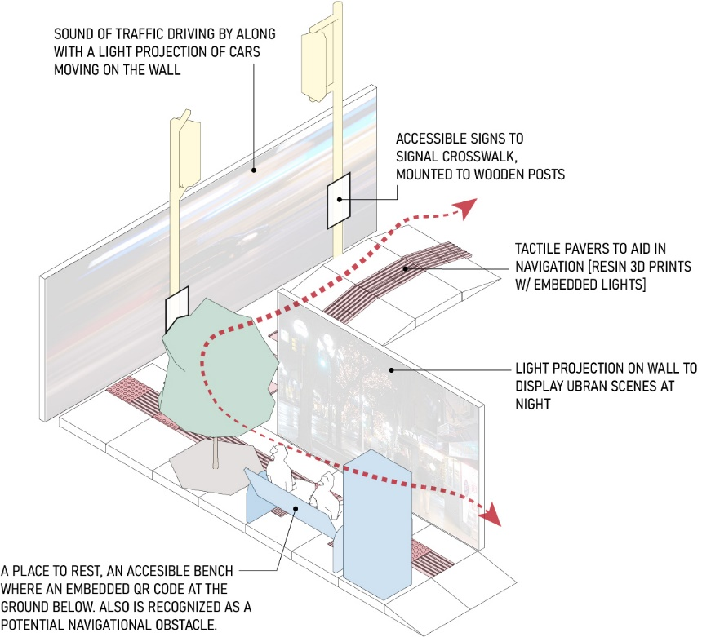
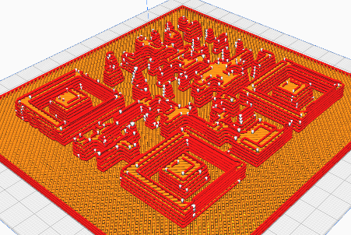
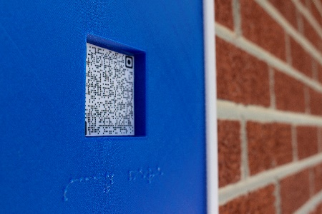
AI-ACCESSIBILITY (3/3)

